Slide 1
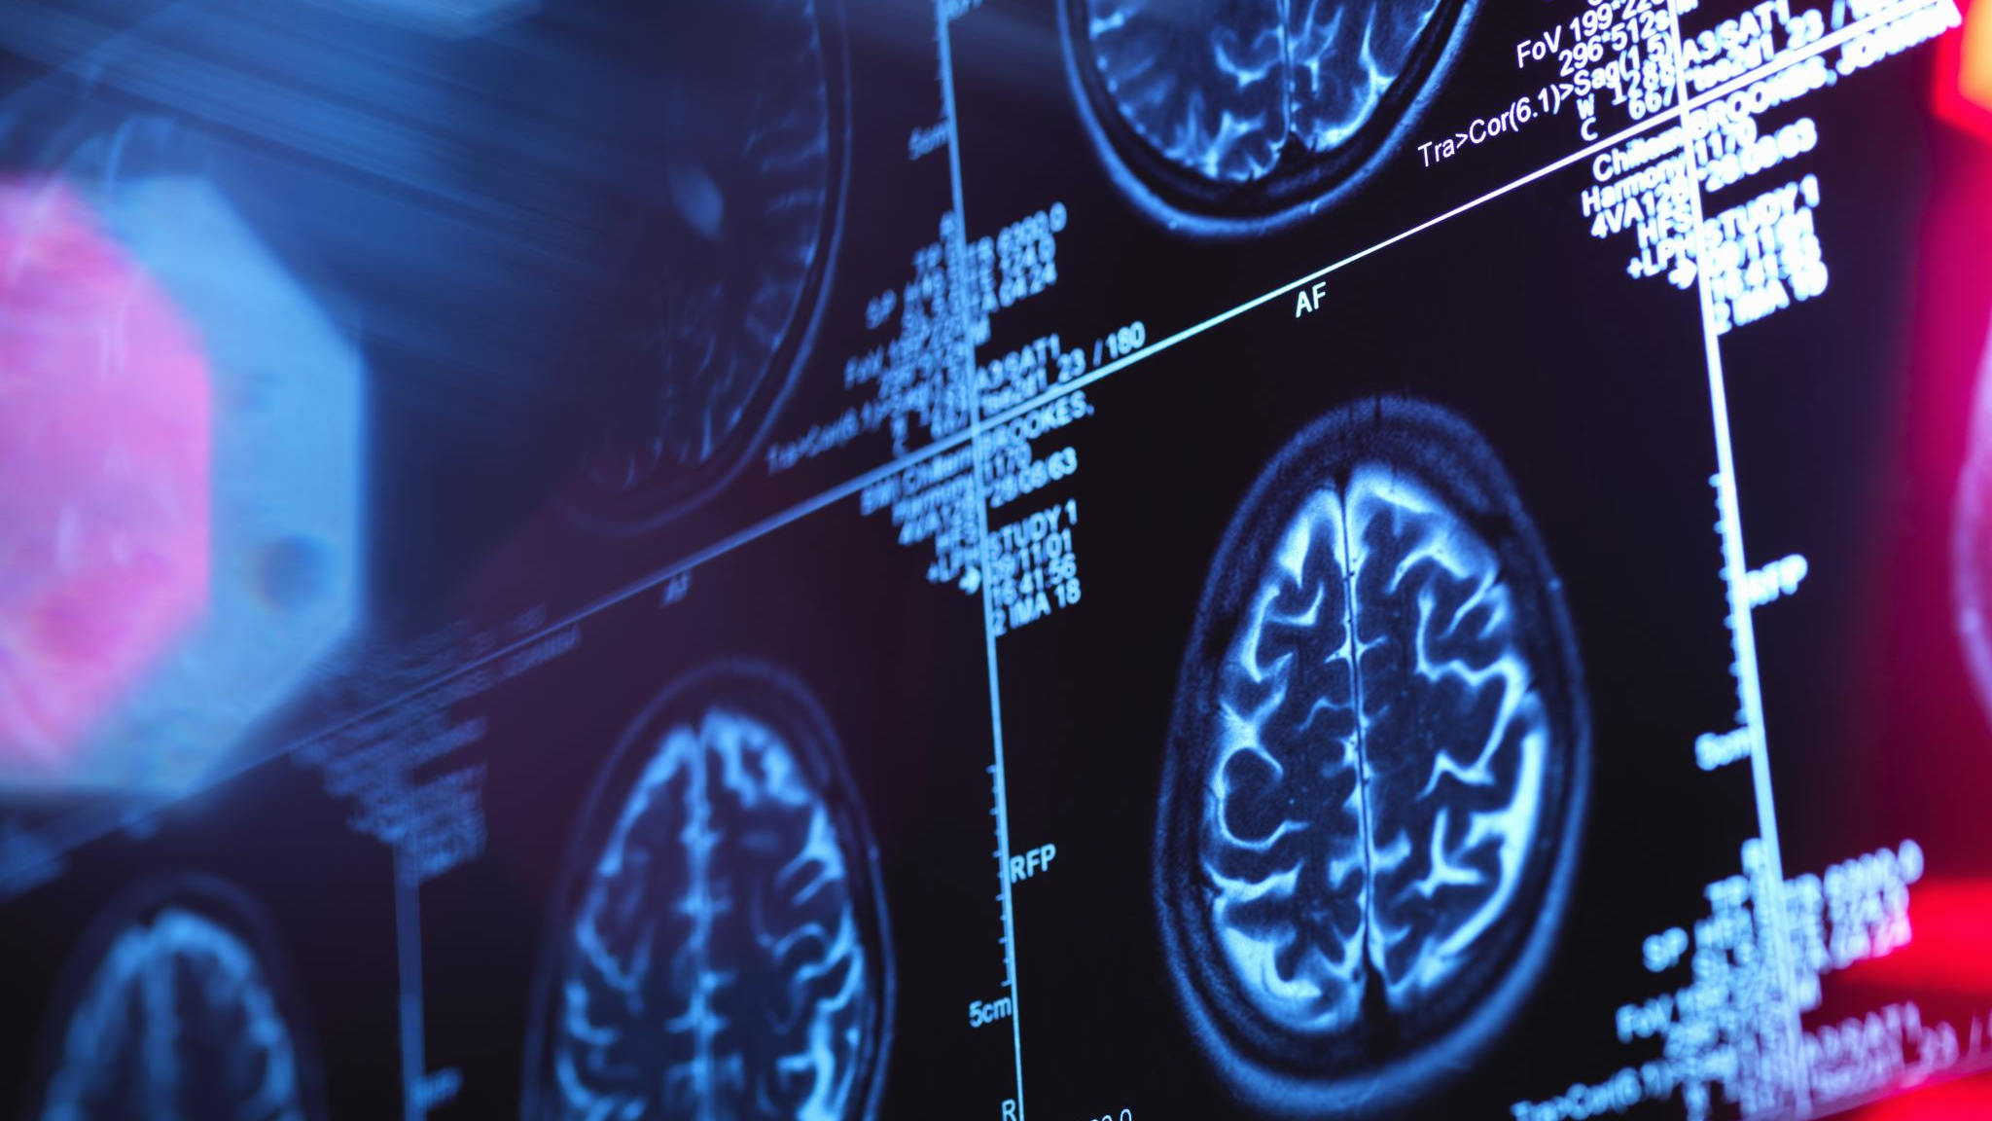
MENTAL HEALTH DETECTOR
AN AI-POWERED TOOL FOR DETECTION AND TREATMENT OF MENTAL HEALTH DISORDERS.
BY GROUP 2.

Slide 2
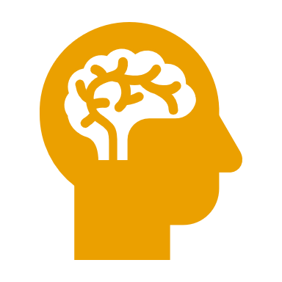
INTRODUCTION.
This project is an integrated mental health assessment tool combining:
Signs-Based Disorder Prediction – Uses NLP to analyse symptom descriptions, identify likely mental disorders, and provide tailored self-care and professional recommendations.
Lifestyle-Based Risk Assessment – Uses machine learning on structured lifestyle and demographic data to predict mental health risk and severity.
Together, these features enable holistic evaluation, early detection, risk scoring, and actionable advice for individuals and practitioners, promoting awareness and informed decisions.

Slide 3
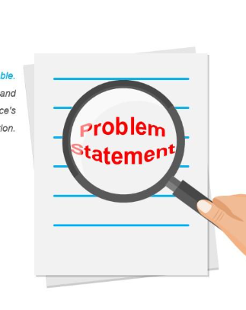
PROBLEM STATEMENT.
Background Mental health affects daily life, but stigma, cost, and limited access—especially in low- and middle-income regions—create barriers to care. With over 1 in 8 people worldwide affected, AI offers a way to detect emotional distress through text, provide supportive feedback, and assist therapists by tracking emotional trends, improving both individual and professional care.
Problem Statement Many face untreated mental health challenges due to cost, stigma, and lack of access. Emotional distress is often untracked, and therapists have limited insight between sessions. There’s a need for private, accessible tools that enable self-reflection and offer valuable data to both individuals and mental health professionals.

Slide 4
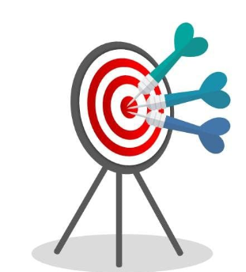
OBJECTIVES.
Analysis-Based Objectives
Detect emotional and linguistic patterns in user text linked to conditions like anxiety, depression, and burnout.
Identify symptom trends and frequencies signaling onset or escalation of challenges.
Classify emotional expressions into broad mental health categories using historical data.
Feature Engineering Objectives
Preprocess text (tokenization, lemmatization, stop-word removal) for clean model input.
Extract features such as emotional tone, symptom keywords, frequency/persistence of states, and time-based changes.
Modelling Objectives
Build and fine-tune a multi-label NLP model to detect multiple co-occurring conditions.
Integrate into an empathetic chatbot that offers daily check-ins, coping strategies, and motivational content.
Assess distress levels to tailor tone and urgency.

Slide 5
DATA DESCRIPTION AND PREPARATION
1. Mental Health Content (mentalhealth.org.uk)
Content: Signs, symptoms, emotional indicators, coping strategies, recommendations of 19 disorders ; (Anxiety,Attention Deficit Hyperactivity Disorder(ADHD),Autism ,Bipolar disorder, Loneliness, Dementia, Depression, Menopause ,OCD, Panic Attacks, Personality Disorder PTSD, Postnatal-Depression, Psychosis, Schizophrenia, Self - Harm ,Stress, Sucidal Thoughts, Trauma)
Purpose: Train emotional tone detection & generate chatbot responses.
Processing:
Clean text data, no missing values.
SentenceBERT embeddings for classification & response modeling.
2. Demographic & Behavioral Data
Features: Age, gender, occupation, diet quality, smoking, alcohol use, sleep hours, physical activity, stress level, social media use, consultation history, medication, work hours.
Purpose: Train CatBoost model for multi-label classification & risk prediction.
Preparation:
Handled missing severity values via mode imputation.
Normalized and encoded categorical variables.

Slide 6
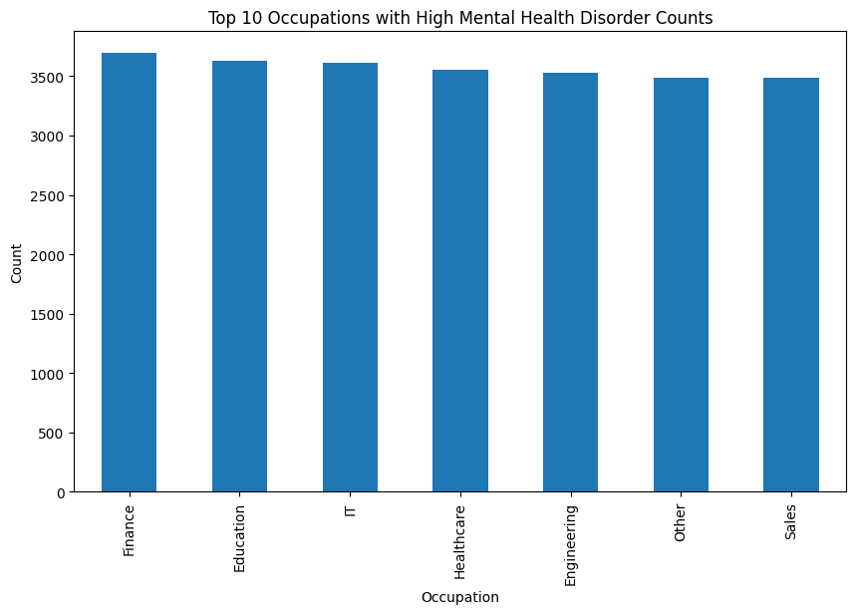
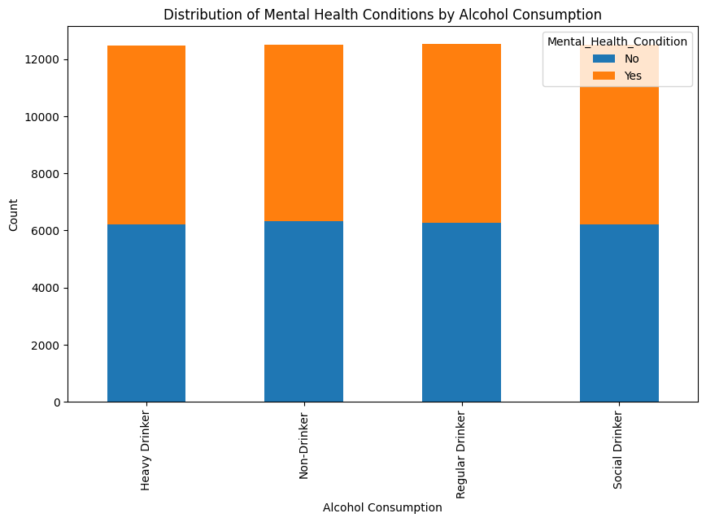
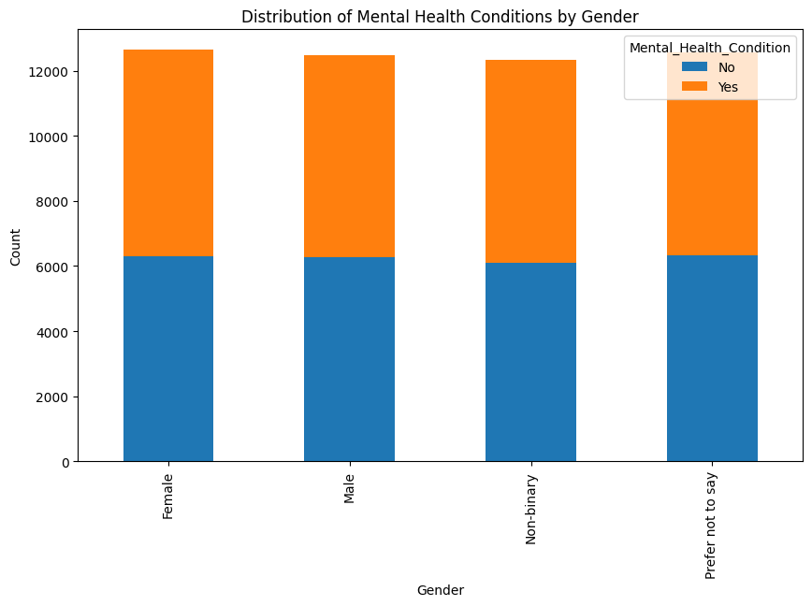
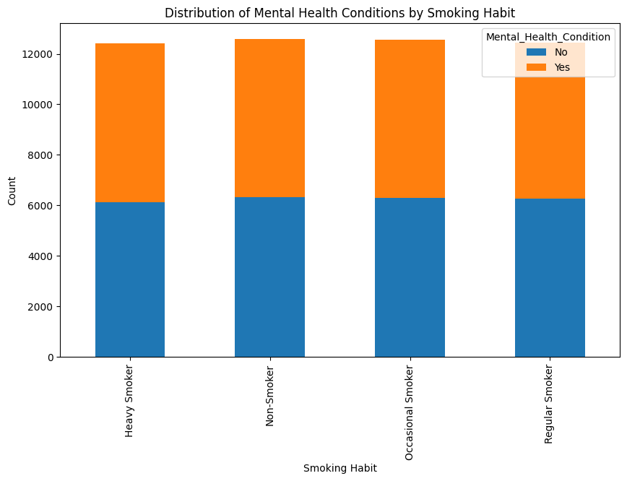
EXPLORATORY DATA ANALYSIS.

Slide 7
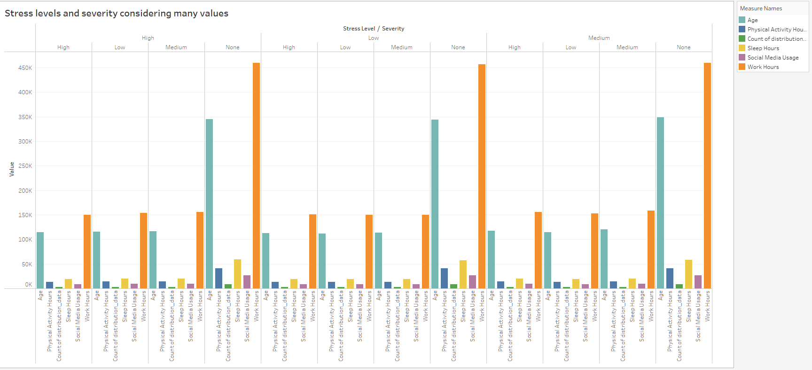
EXPLORATORY DATA ANALYSIS

Slide 8

MODELLING AND EVALUATION.
1. Text-Based Modeling
Input: User symptom descriptions & journal entries
Processing: SentenceBERT embeddings → Multi-label classifier
Goal: Detect conditions like depression, anxiety, burnout
Integration: Empathetic chatbot offering condition-specific suggestion.
2. Structured Data Modeling
Input: 13 behavioral & demographic features (age, gender, occupation, alcohol, smoking, sleep, physical activity, stress, etc.)
Models: Stacked Gradient Boosting + CatBoost (also LightGBM in ensemble)
Target: Multi-label classification + severity prediction (mild, moderate, severe)
Average Severity Precision; 0.667,
Average Severity Recall; 1
Evaluation Metrics.

Slide 9
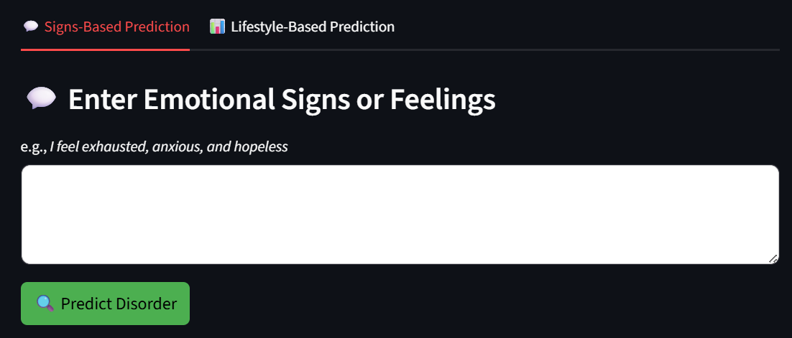
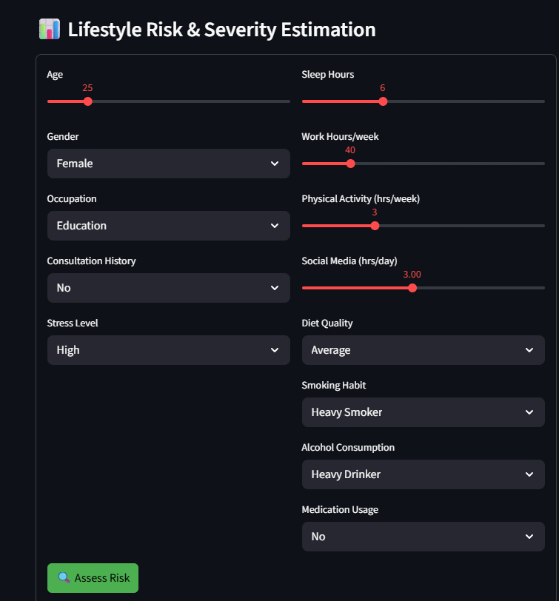
DEPLOYMENT
Platform:
Streamlit: Local interface for running the app
FastAPI: Backend for scalable model inference
Ngrok: Expose app online for testing
Modes:
Signs-Based: NLP prediction from user-described symptoms
Lifestyle-Based: Structured data prediction from age, stress, sleep, etc.

Slide 10
CONCLUSIONS AND RECOMMENDATIONS
Conclusions.
The Mental Health Prediction Assistant combines NLP-based symptom analysis with structured lifestyle data for early detection and personalized support.
It provides scalable mental health screening, tailored recommendations, and a modular, user-friendly architecture suitable for digital health platforms or personal self-assessment.
Overall, it helps bridge the gap between early signs of distress and timely intervention.
Top Recommendations
Model Performance Improvement: Use advanced NLP embeddings (e.g., OpenAI embeddings, ClinicalBERT) to enhance classifier accuracy.
User-Centric Refinement: Integrate user feedback into the UI to dynamically improve predictions and recommendations.
Integration of Multi-Source Data: Incorporate wearable health tracker data (sleep, heart rate, activity) to improve prediction reliability.

Slide 11
NEXT STEPS
Continuous Learning System - Build a feedback loop where user-confirmed diagnoses and lifestyle updates are fed back into the system for continuous model retraining.
Multilingual Support - Expand the system to handle multiple languages to serve a wider audience.
Regulatory Compliance - Adapt the platform to comply with HIPAA, GDPR, and other health data regulations depending on target regions for deployment.

Slide 12


